Slide 1
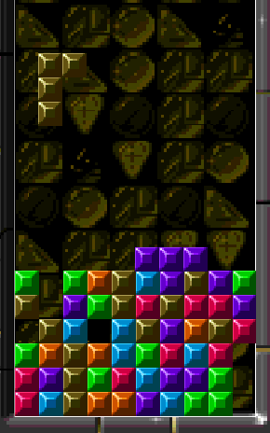
Applying reinforcement learning to Tetris A reduction in state space
Underling : Donald Carr
Supervisor : Philip Sterne

Slide 2
Reinforcement learning
Branch of AI
Characterised by a lack of direct interaction between programmer and artificial agent.
Agent is given access to simulated environment and develops its own tactics through trial and error.

Slide 3
Reinforcement learning
Characterised by :
  4 components
    Policy
      A mapping from state to action
    Value function
      A description of long term reward
    Reward function
      A numerical response to goal realisation/alienation
    System model
      Internal representation of system

Slide 4
Intricacies
No initial assumptions on part of program
Many established weighting functions used to develop the value function. Encourage persistent learning, or converging to an optimal solution
Exploration vs. exploitation

Slide 5
Its all been half-done before
Yael Bdolah & Dror Livnat
http://www.math.tau.ac.il/~mansour/rl-course/student_proj/livnat/tetris.html
S Melax
www.melax.com/tetris/

Slide 6
Dimensionality
“the curse of dimensionality“ – Richard Bellman
Using a binary description of the blocks, each additional block doubles memory requirements
Exponential complexity

Slide 7
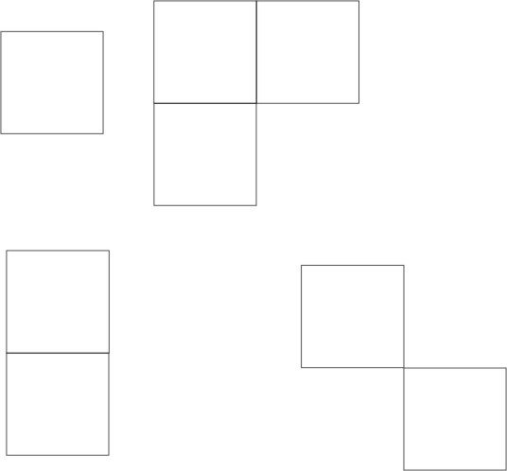
Consequence
Successfully applying reinforcement learning to hobbled Tetris

Slide 8
Redefine your enemy
Resting environment is tiny
2 by 8 blocks
= 2^16 possible states
Blocks fall from an infinite height
  There is infinite time for decision
  Placement options do not decrease as time progresses
  Goals remain constant over time
Linear risk vs. reward response

Slide 9
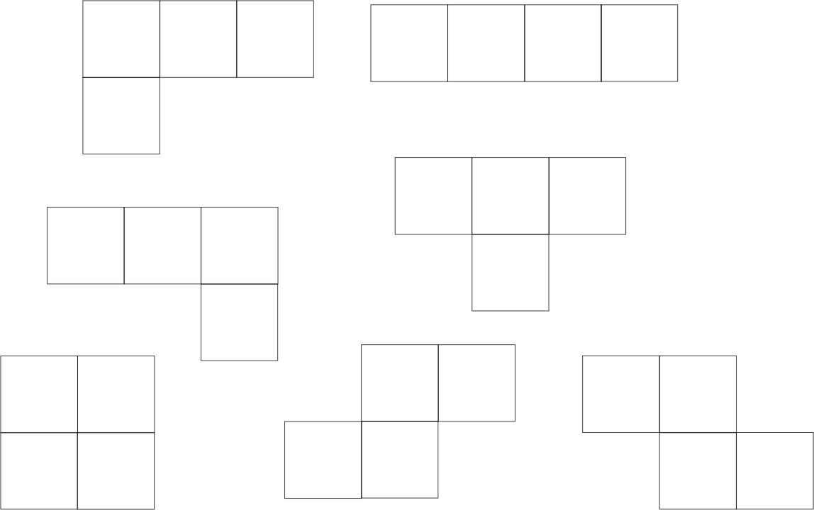
Reality in contrast

Slide 10
The human lot
Environment is massive
  13*20 blocks
  = 2^260 possible states
The are very real time constraints with the number of options decreasing as block descends
Successfully completing 4 rows carries 16 times the reward of completing 1 row, but also carries much higher risk
Logical tactics change as finite stage fills up. e.g. Don’t risk 4 row completion with 2 empty rows remaining

Slide 11
No hand : Just boot or sweetie
No explicit tactics yielded to computer (digital virgin)
Given sensory perception via our description of the system
Given ability to rotate and manoeuvre Tetris piece
Receives external reward or punishment we associate with state transitions
Given long term memory

Slide 12
School of hard knocks
Iterative training
Agent goes from completely ignorant entity to veritable veteran in iterative process
Rate of learning
Depth of learning
Flexibility of learning
Balance between common parameters

Slide 13
Refocus
Focus of project is on minimising state space
  Implementing Tetris specific solutions
    mirror Symmetry : sqrt of state space
    Focusing on restricted section of formation e.g. top 4 rows of formation
    Considering several substates
  Researching and implementing general optimisations
  Possibly utilising other numeric methods to find best possibility in state space (standard description involves linear iterative search for alternative with maximum value)

Slide 14
Strategic planning
Toying with methods of representation - ongoing
Code / Hijack Tetris
Basic learning
Increasing complexity of system
Increasing complexity of agent
Noting shortcomings and countering flaws
Looking for generality in optimisations
Look for direct application to external problems
Look for similarities in external problems

Slide 15
Fuzzy outline
4 weeks : Research period
1 week : Code Tetris and select structures
3 weeks : Achieve basic learning with agent
5 weeks : Optimisation of state space
3 weeks : Testing

Slide 16
Possible outcomes
Optimisations capable of extending reinforcement learning to problems previously considered outside of its sphere of application
Unbiased flexibility of reinforcement learning applied to a problem it is ideal for
A possible contender for the Tetris world record (algorithmic)
http://www.colinfahey.com/2003jan_tetris/tetris_world_records.htm

